Slide 1
Module 3
The Promotion

Slide 2
4. Promotion

Slide 3
Promotion
Promotion is the way in which a business makes its products known to the customers, both current and potential ,and persuades them to buy.
It is a common mistake to believe that promotion is all about advertising. It isn’t.
There are a variety of approaches that a business can take to get their message across to customers, although advertising is certainly an important one.

Slide 4
Main aims of promotion
The way in which promotion is targeted is traditionally split into two types:
ABOVE THE LINE promotion –communication in the independent media Though it can be targeted, it could be seen by anyone outside the target audience. Advertising is the main method of above-the-line promotion.
BELOW THE LINE promotion – promotional activities where the business has direct control e.g. Sales promotions, in store materials. It is aimed directly at the target audience.

Slide 5
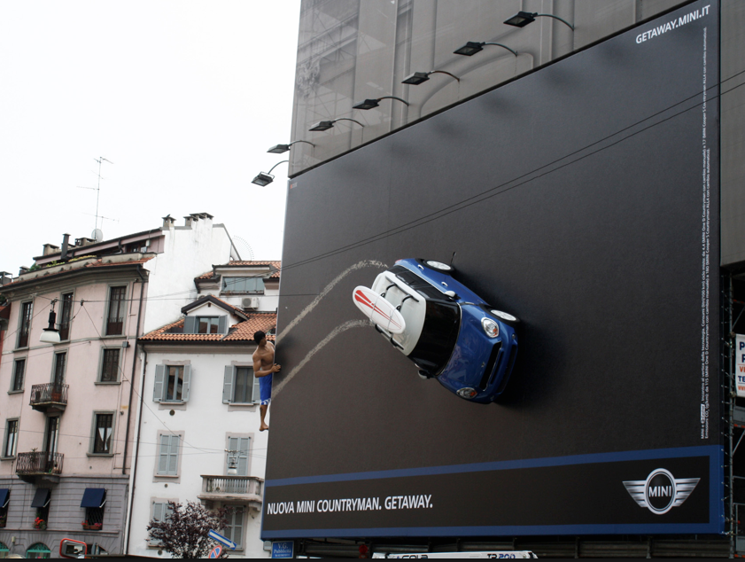

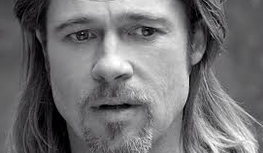
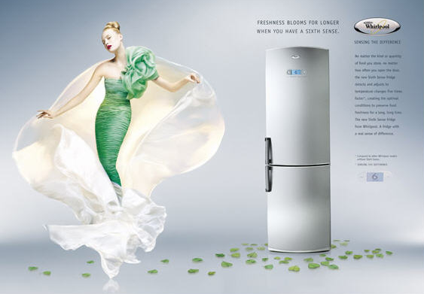
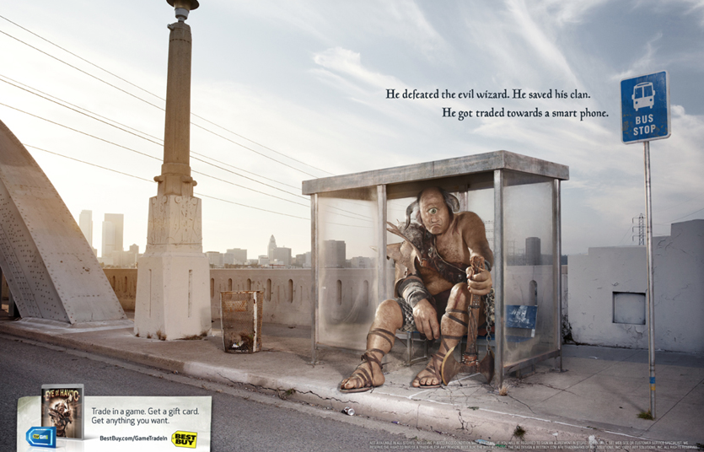
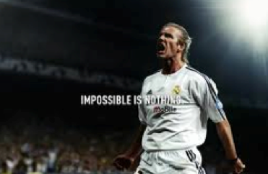
What is Advertising?
Advertising presents or promotes the product to the target audience through a variety of media such as TV, radio, cinema, online and magazines to encourage them to buy.
The problem with advertising is that consumers are bombarded with messages every day. How can a business cut through the advertising noise and get a message across effectively?

Slide 6
The art of advertising
Advertising works best and costs the least when you pay attention to : Planning, Preparation, and Persistence. Some more strategies intervene in modern advertising like:
Surprise
Sophistication
Emotions
Artistic talent
Heavy Budget
Voice
Sense of Humour
Can you think of a TV commercial for each of the above elements?

Slide 7
Sales promotion
There are many methods of sales promotion, including:
Money off coupons
Competitions
Free gifts
Point of sale materials
Loyalty cards
They also provide information about the shopping habits of customers – where do they shop, when and what do they buy? This is very valuable marketing research and can be used in the planning process for new and existing products.
What could the problems be related to sales promotion?

Slide 8
Media Planning
Media Planning must consider the available resources but also the nature of the product and the potential of the media.
TRADITIONAL MEDIA
tv: large audience, lots of dispersion, very expensive, visual/audio based, triggers emotions, short termed, testimonials, work of art
radio: medium audience ,possibility to target, no visual, annoying, some are memorable, low budget , easy message
newspapers: large audience, possibility to target, reading focus, expensive, stays on
billboards: fast , concise message, goes locally,
xl outdoor: self assertive, very visible, prestigious, good for branding , xl expenses
NEW MEDIA
This are often included web marketing, guerrilla marketing, mobile marketing .They provoke surprise, emotions, and establish a stronger relation with the audience. they trigger social networking dynamics , and a lot of buzzing.

Slide 9
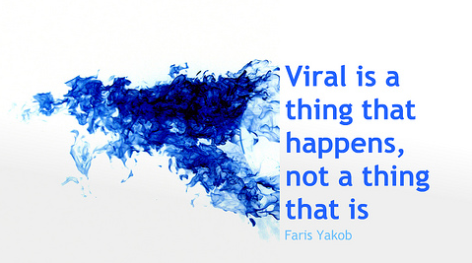
Viral marketing

Slide 10
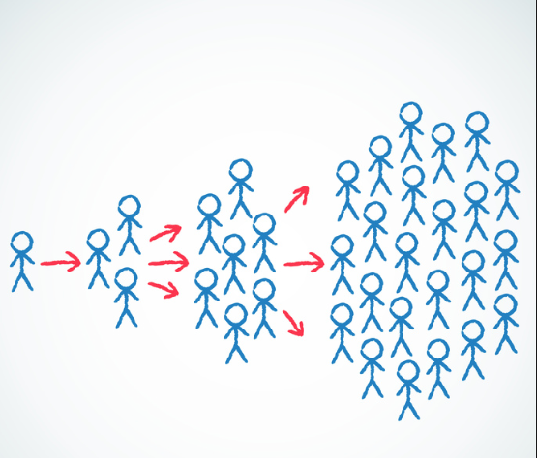
Viral marketing
A viral campaign is a marketing blitz that essentially creates a content which is cool and interesting enough that consumers will spread it on its own. Viral marketing is a marketing strategy that relies on individuals rather than traditional campaigns to pass along a message to others. It usually refers to marketing on the Internet. It spreads rapidly, like a biological virus.
The term "viral marketing" first became prominent when used to describe a marketing campaign for the e-mail service Hotmail.com. When the company launched, every outgoing message contained an advertisement for Hotmail and a link to its website at the bottom of the e-mail. As people e-mailed their friends and colleagues, they were also advertising the service.

Slide 11
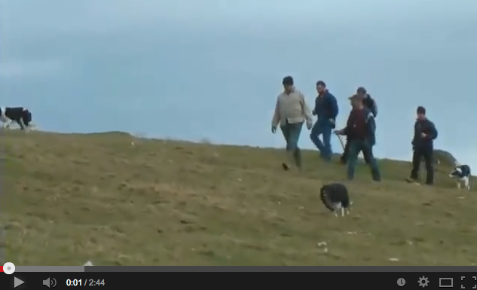
Viral marketing
A viral marketing strategy need not contain ALL these elements, but the more elements it has, the more powerful the results are likely to be. An effective viral marketing strategy:
Provides for effortless transfer to others;
Scales easily from small to very large;
Exploits common motivations and behaviors;
Utilizes existing communication networks;
Takes advantage of others’ resources: As big name companies started to realize they could trick their customers into doing all the advertising at a fraction of the cost with viral marketing, they began recruiting all sorts of independent artists to create videos .
Sometimes a campaign is designed to be viral. Sometimes it gets there on its own.

Slide 12
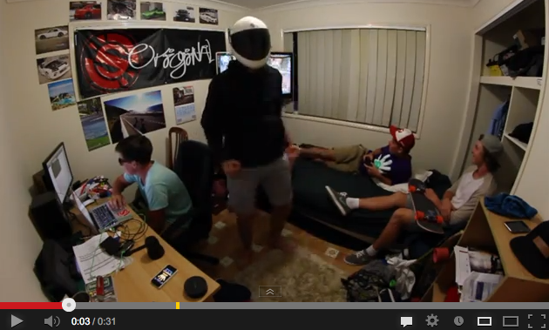
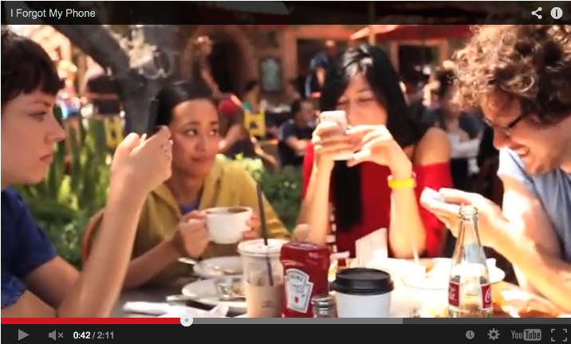
The potential of Viral videos
For those unfamiliar with the Harlem Shake, the craze began with a video posted by YouTube personality Filthy Frank on Feb. 2 2013. Thousands and thousands of people made YouTube videos which employed an electronic ditty, created by the Brooklyn DJ Baauer, as the soundtrack for a deliriously silly template: For the first 15 seconds or so of the video, one person in a group is dancing; then, after 15 seconds, suddenly everyone in the group is wildly freestyling. Some of the videos are pretty funny, some are amateurish and the whole thing just looks like a lot of people having fun. That’s enough to make “Harlem Shake” the “biggest thing and ultimate revenue potential according a company called INDmusic, which helps monetize the label’s video views through pre-roll ads -- like a Vevo, essentially. They have claimed over 4,000 user-uploaded videos featuring the song totaling over 30 million views in just a week. It is people “actively” watching and the overall number of clicks in is certifiable.
(here below Harlem Shake 61,588,164 views and I Forgot My Phone 38,845,573 views)

Slide 13
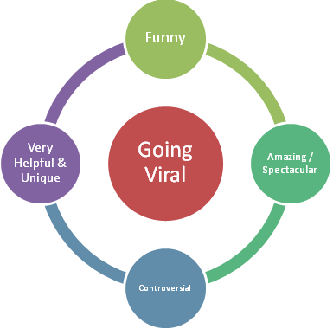
Why it spreads
Why people pass it on?
It’s entertaining. The content inspires a certain emotion whether it be anger, fear, love or happiness.
“What is that?!” There must be something new and exciting It’s a unique, unexpected and memorable, message.
“there’s nothing people like more than surreal, nonsensical humour that they can quote endlessly. This is what spreads on the Internet first and foremost, and are often the drivers of what is considered “cool”. People want to be famous and cool. They want to feel wanted and appreciated.
It exists in the same universe as you and your closest friends
It is easy to transmit.

Slide 14
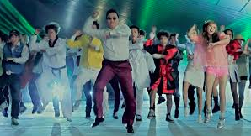
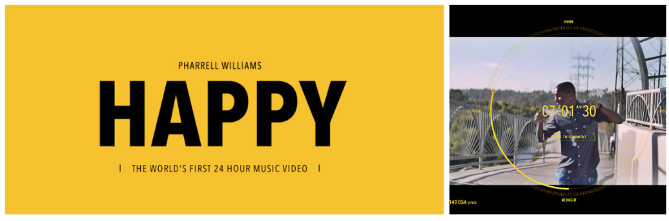
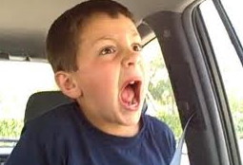
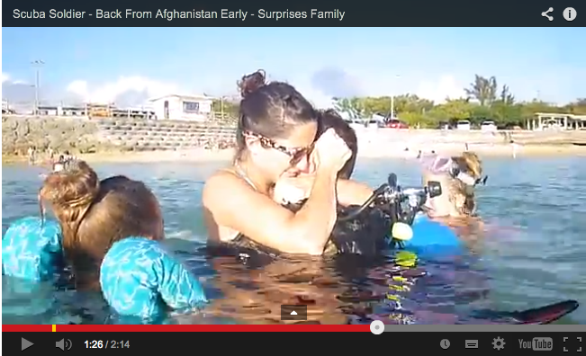
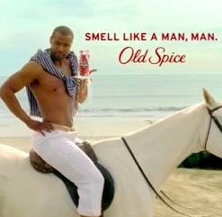
Viral videos
A succesful viral video is tagged by traditional commercials to exploit its potential (Vevo)(here below:, Gangnam style 1,882,751,565 views)

Slide 15
Viral videos
Viral videos have different characteristics from traditional videos that are designed for traditional media:
 | TRADITIONAL VIDEO | VIRAL VIDEO
PRODUCT | PREMINENT | NOT VERY VISIBLE
QUALITY | PROFESSIONAL | AMATEURISH
TESTIMONIALS | VIP | NORMAL PEOPLE
HIGHLIGHTS | PRODUCTION (Scenography/Special effects/Sophistication/Art Directions/ make up/Hair stylist/soundtrack..) | SENSE OF HUMOUR/SURPRISE/EMOTIONS
BUDGET | HEAVY | LIMITED
STORY | IMAGINARY/VISIONARY | EVERY DAY LIFE

Slide 16

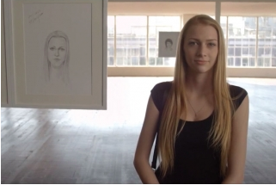
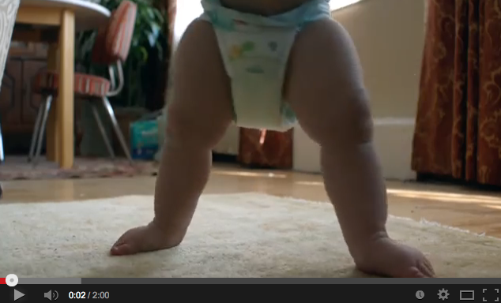
Viral WEB campaigns
Some campaigns are designed to be viral. Here the story is more important than the product. In fact, it may not even be shown yet the ad is memorable because of the story.
1. Volkswagen: The Force. Agency: Deutsch, Los Angeles Launch date: Feb. 3, 2013
Views: 62.7 million
Volkswagen gave this video the ultimate paid placement in the Super Bowl but launched it the previous week on the web, where it garnered 14 million views before the game. One of the most-watched viral ads of all time.
2. DOVE: Real Beauty Sketches. Agency: Ogilvy & M. Brazil debuted on April 14, 2013
Views: 134,.9 million
This spot impressed. In it, an FBI sketch artist asked individual women to participate in a study to first describe themselves and then a stranger seated next to them earlier in the day.The results showed very different images— the self-descriptions would reveal the women's insecurities. In May, it took the Cannes Lions International Festival of Creativity's highest honor a prize only awarded for innovative and transformational work.
3. P&G: Thank you mom. Agency: Wieden+Kennedy,, Los Angeles Launch date: January 6, 2014
Views: 17,8 million
Marking one month until the start of the Olympic Winter Games, Procter & Gamble celebrates how moms are there along the journey to pick their kids back up and encourage them to try again. One major part of that journey will be watching their kids compete in Sochi.

Slide 17
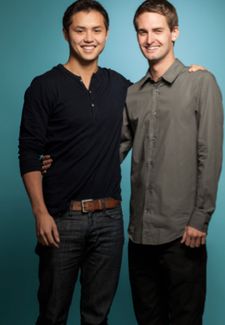
SNAPCHAT a viral success
Snapchat represents the greatest existential threat yet to the Facebook. Today’s teens have finally learned the lesson : What you post on social media–the good, the bad, the inappropriate–stays there forever. And so they’ve been signing up for Snapchat.
FORBES estimates that 50 million people currently use Snapchat an app that makes photos disappear. Median age: 18. Facebook, meanwhile, has seen a decline among teenagers. Its average user is closer to 40. Snapchat users send 400 million photos and videos each day, matching the daily uploads to Facebook and Instagram combined.
An entire subindustry–so-called “temporary”, has emerged behind it. Besides Poke, there’s Clipchat, Wickr and dozens of other apps pushing digital communication back toward what a telephone call used to be: a way to communicate with little risk it will come back to bite you.

Slide 18
The story of SNAPCHAT a viral success
THIRTEEN MONTHS AGO Facebook’s Mark Zuckerberg, the richest twentysomething in history, reached Evan Spiegel, who created Snapchat, with an invitation, delivered to his personal e-mail account: “Come here and let’s get to know each other”. Spiegel, now 23, responded : “I’m happy to meet you… if you come to me.”
And so, Zuckerberg flew to Spiegel’s hometown, Los Angeles. Zuckerberg described Facebook’s new product, Poke, a mobile app for sharing photos and making them disappear. It would debut in a matter of day ,it was basically like : ”we’re going to crash you”. Spiegel immediately returned to his office and ordered a book for each of his six employees: Sun Tzu’s The Art of War.
When Poke debuted, on Dec. 21, 2012, Zuckerberg e-mailed Spiegel, telling him that he hoped he enjoyed it. Spiegel, who had deactivated his Facebook account, found Poke was a near-exact copy.
But a funny thing happened. The day after its launch Poke hit number one on the iPhone app store. But within three days, Snapchat went ahead,as the Facebook app disappeared from the top 30. Spiegel said: “It was like, ‘Merry Christmas!’ ”

Slide 19
The story of SNAPCHAT a viral success
As user numbers approached 1,000, an odd pattern emerged: App usage peaked between 9 a.m. and 3 p.m.–school hours. It gave them all the ability to pass visual notes during class–except, the evidence vanished. Usage doubled among teens at school and users surged that December to 2,241. By January it was at 20,000; by April, 100,000.
Which helps explain what happened in the fall when Zuckerberg reached Spiegel, basically ready to surrender on terms of $3 billion in cash for a two-year-old app with no revenue.
Spiegel refused it. It was the most scrutinized business decision of the past year. The roots of that decision, however, were obvious. Chapter 6 in the Art of War specifically addresses the need to attack an enemy where and when he displays weakness. Spiegel insists that rather than selling, they’re aiming to grow:
“There are very few people in the world who get to build a business like this,” says Spiegel. “I think trading that for some short-term gain isn’t very interesting.”

Slide 20
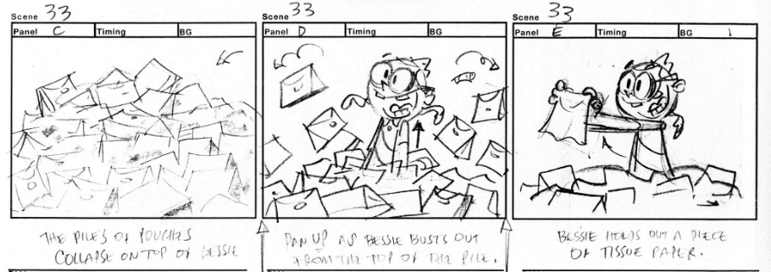
Your task
Consider the elements you have about the product:
What type of use do the teens do of it? What other uses can you imagine? Consider the elements of Viral videos we saw: Then , imagine a storyboard for a viral video of Snapchat and describe it to the class.

