Slide 1
Module 4
Guerrilla marketing

Slide 2
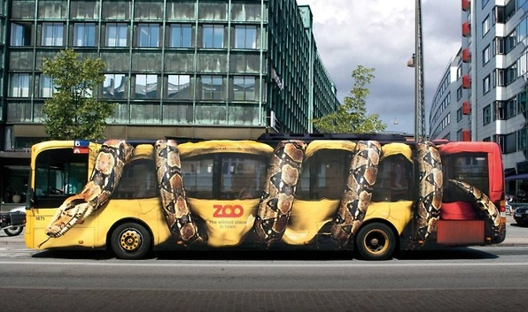
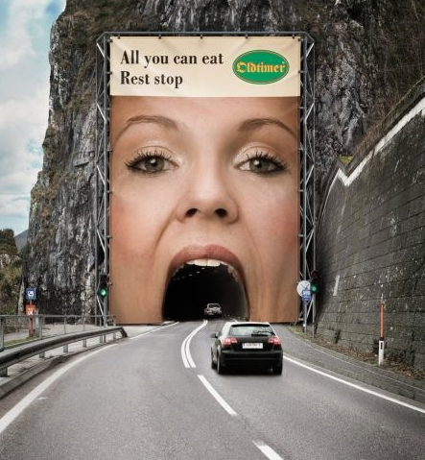
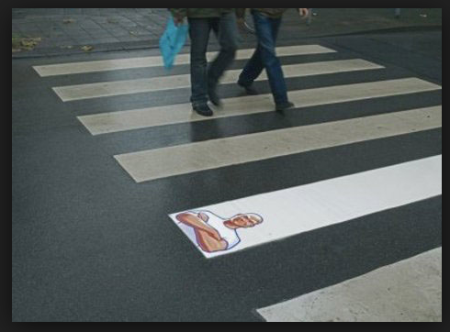
Guerrilla Marketing
The term guerrilla marketing was inspired by guerrilla warfare which is a form of irregular warfare and relates to the small tactic strategies used by armed civilians. Many of these tactics includes ambushes, sabotage, raids and elements of surprise. This alternative advertising style relies heavily on unconventional marketing strategy and imagination. Guerrilla Marketing is about taking the consumer by surprise, make an indelible impression and create social buzz. Guerrilla marketing is said to make a far more valuable impression with consumers in comparison to more traditional forms of advertising. This is due to the fact that most guerrilla marketing campaigns aim to strike the consumer at a more personal and memorable level.

Slide 3
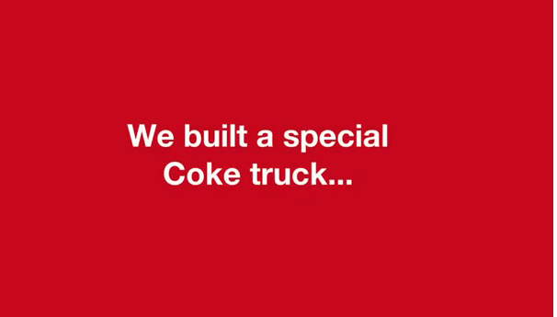
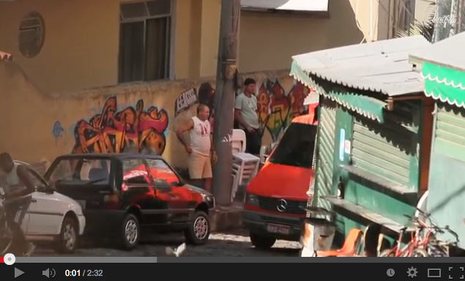
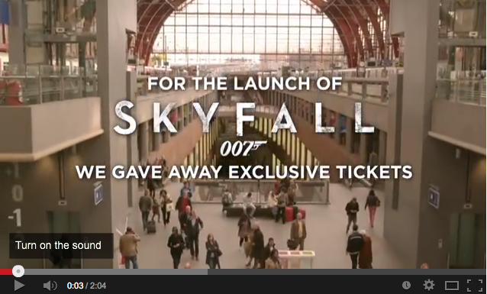
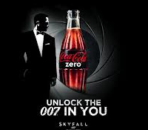
Guerrilla Marketing
Sometimes Guerrilla Marketing is complement to traditional medias, like Coca Cola Happiness truck.

Slide 4
GO PRO The World's Hottest Camera
Nick Woodman is 37 years old and he’s become one of America’s newest and youngest billionaires.
A decade ago Woodman wanted a camera he could strap to his wrist so that his friends could see his surfing exploits. The result is now a consumer phenomenon called GoPro or America’s fastest-growing digital imaging company.
Go anywhere active these days, whether it’s the mountains or Honolulu’s Bay, and you’ll see a GoPro or 20. Kids these days don’t film their wave rides or tricks. They GoPro them, strapping the $200 to $400 cameras to helmets, handlebars and surfboards.
The cinema-grade, panoramic “point-of-view” footage that comes out of a GoPro transforms mere mortals into heroes. Shaun White, used GoPros on his runs during the Winter X Games. Hollywood directors, keep tons of them on set. It has been tested to capture touchdown replays. The Rolling Stones deployed them on stage. Police forces and the U.S. military have started to incorporate the cameras into training exercises.
GoPro sales have more than doubled every year since the first camera’s debut in 2004. In 2012 the company sold 2.3 million cameras. For the month of December GoPro was the highest-grossing digital imaging brand, knocking out Sony for the first time in the distribution chains’ history.

Slide 5
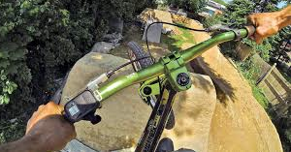
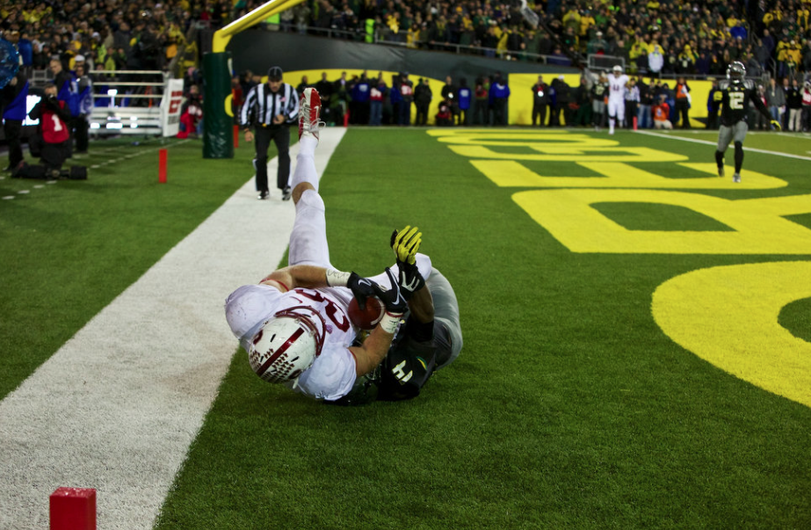
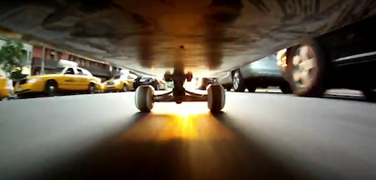
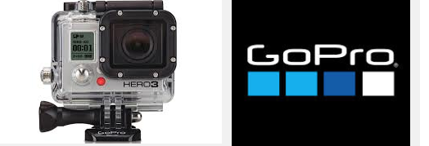
GO PRO The World's Hottest Camera

Slide 6
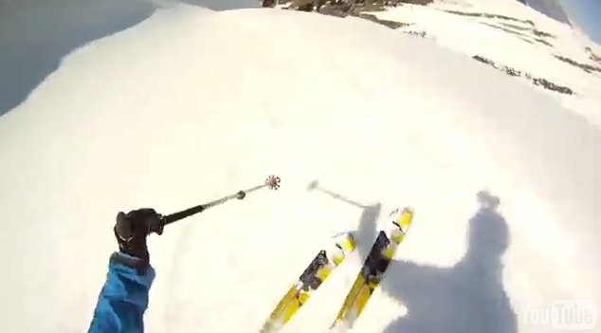
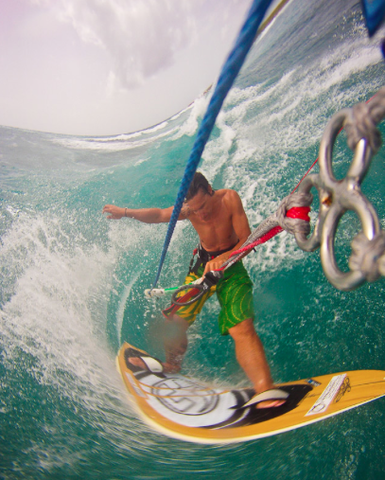
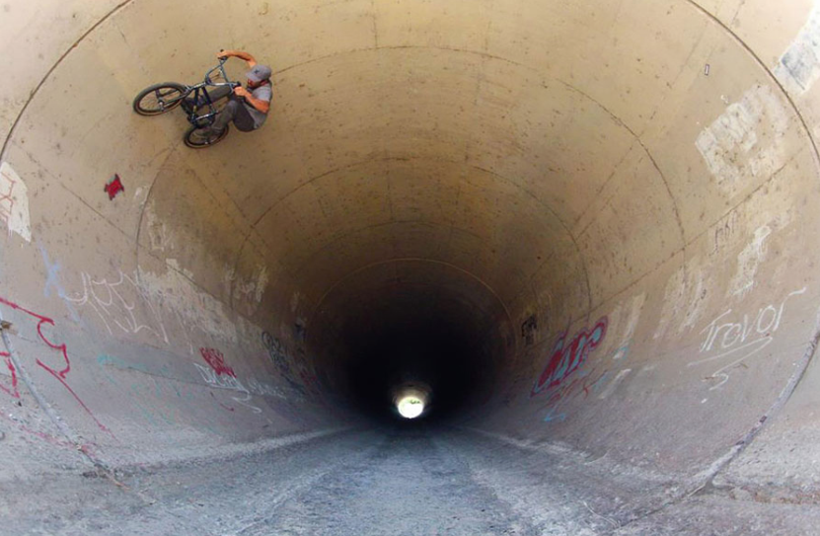
GO PRO or the World's Hottest Camera
The ego-crazy extreme athlete is a narcisist. He wants the very best documentation of his or her exploits. But this involves a lot of non professionals also. What sounds like the most banal subject in the world is transformed through a single Hero 3+, and in GoPro editing software, into an amazing-looking event. In GoPro things seem to be happening faster, and more explosively, than in real life — making “an experience look better than it really was,” “people become addicted to your product — because it makes them look insanely good.”
Also, GO PRO was born right during the rise of YouTube and our documentation-crazy culture that makes images of practically everything . Self-documentation has become the best world’s pastime.

Slide 7
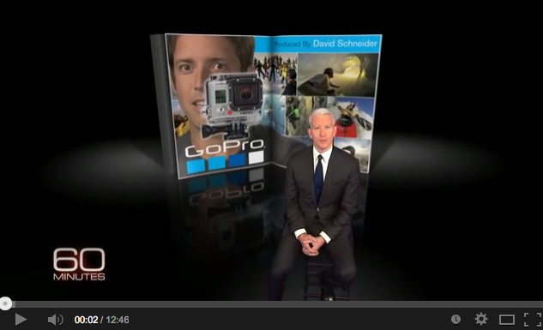
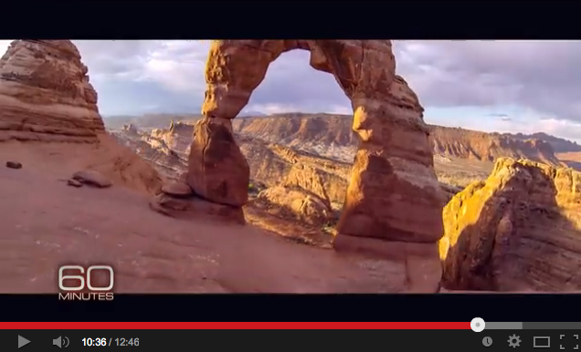
Create a GM project
Think of the elements you have: the target : (pro but non pro also) and the characteristics they have. Think of the caracteristics of the product, its versatility (what you can do with it) and its claim: “be a hero”.
Think of the caracteristics of Guerrilla marketing we have illustrated.
Now try and imagine a catchy Guerrilla Marketing operation for GO PRO (claim: Be a hero) , it must be easy to reproduce internationally, and generate a video ready to go viral)

