Slide 1
Module 1
Marketing and Product

Slide 2
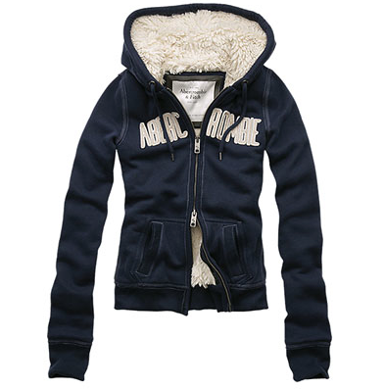
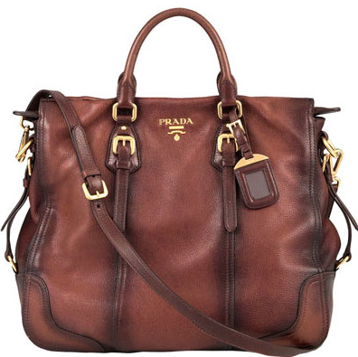
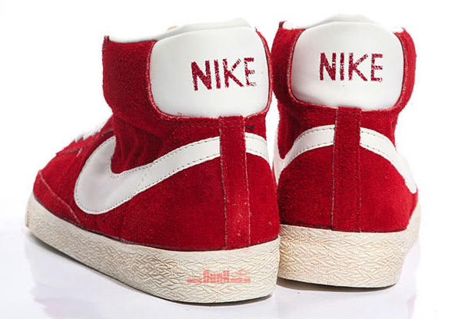
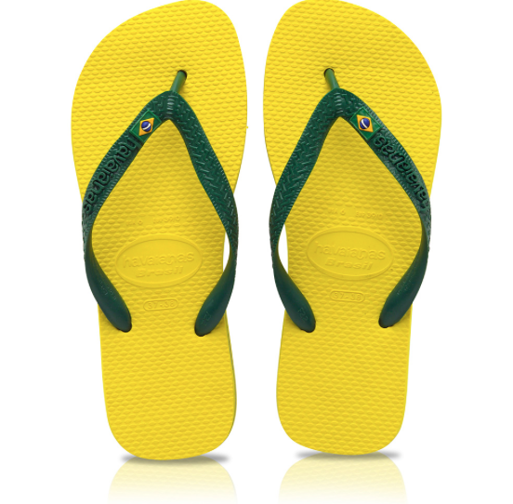
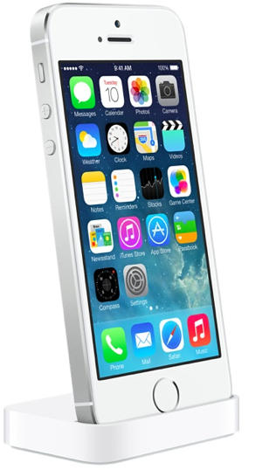
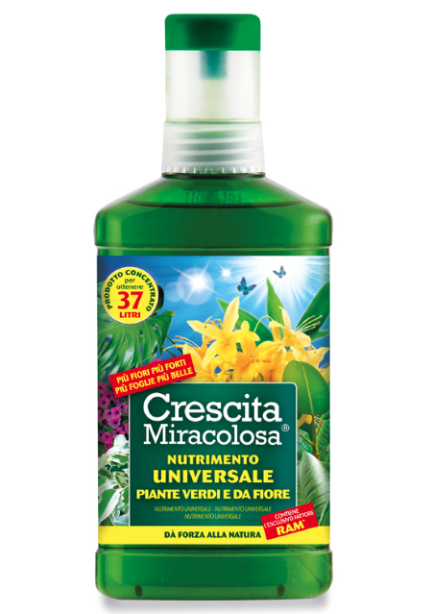
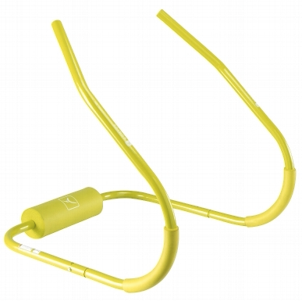
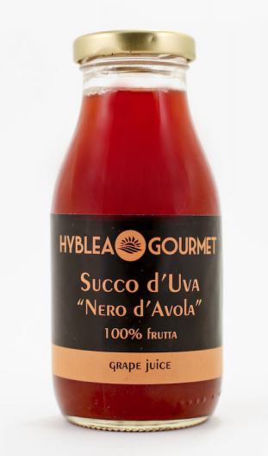

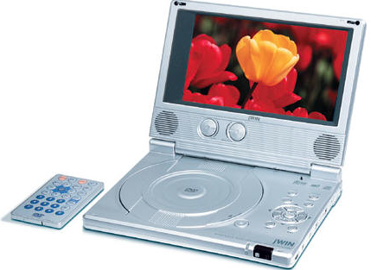
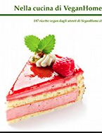

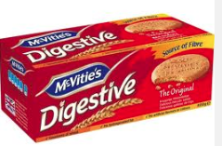

Why people don’t buy

Slide 3
What marketing is
“Every sale has six basic obstacles:
no need, no money, no hurry, no desire, no trust, no time”

Slide 4
What marketing is
“Every sale has six basic obstacles: no need, no money, no hurry, no desire, no trust, no time”
Marketing helps to remove all these hurdles and convert them in opportunities for the company to attract new customers.
Product innovation
Price reduction Place change
Promotion desirability

Slide 5
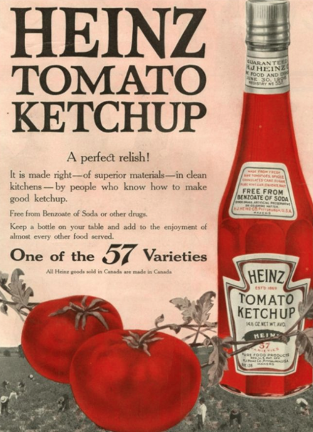
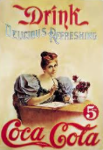
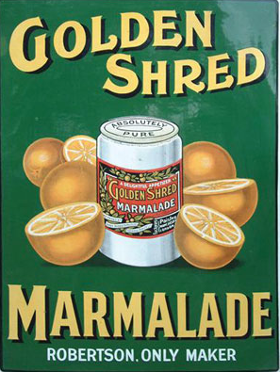
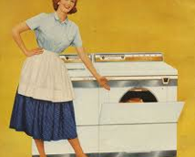
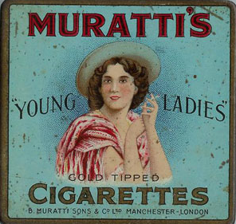
marketing
What was marketing?
In the ‘40s- 50s- 60s marketing was similar to advertising. It was a simple world with few brands competing so it meant letting people know that a new product was available: the customer came after the product. Nowadays the customer often comes “before” the product. What is the meaning of that?

Slide 6
1.STRATEGIC Marketing
What marketing is
Marketing is a very complex process and advertising is just one of its many aspects.
Nowadays, Marketing is a planning process that :
2.MARKETING MIX (Product, Place, Price, Promotion)
3. OPERATIVE Marketing & Communication
tries to convince potential customers to buy.
identifies the target and the needs
helps create a product to meet this requirements
--------------------------------
Readjusts the mkg mix
0. Marketing RESEARCH
understands the buying behaviour of the customer, what he is influenced by , what the competitors offer and many more things

Slide 7
1. Identification of the target
An essential process in the identification of the target is Segmentation. Segmentation is all about understanding and analysing the target customers in order to split it into relevant sections .
There are many ways in which a market can be broken down into segments. A very popular method of “demographic” segmentation looks at factors such as:
Age
Gender
Income
Social class
Why do companies bother segmenting a product? Is it risky? Is it an opportunity?

Slide 8
Segmenting the market
Segmentation is to make marketing more effective: by identifying groups of customers who have similar needs companies find a way of positioning a product in a way which is attractive to those customer groups.
It is also an opportunity for upselling.
But, it can also be risky: if I individuate a useless/non existing target I only waste money .

Slide 9
2.The Marketing Mix
The marketing mix deals with the way in which a business uses price, product, distribution and promotion to market and sell its product.
The marketing mix is often referred to as the “Four P’s”:
Product
Price
Place
Promotion
For most businesses, one or two elements of the mix will be seen as relatively more important than the other

Slide 10
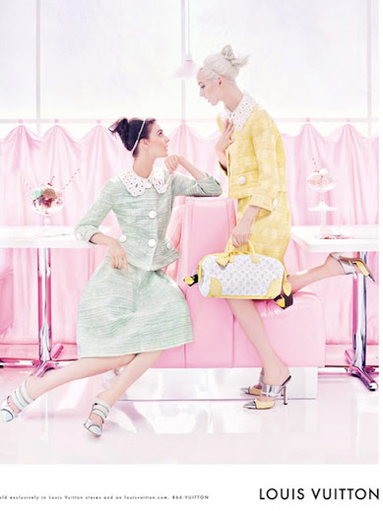
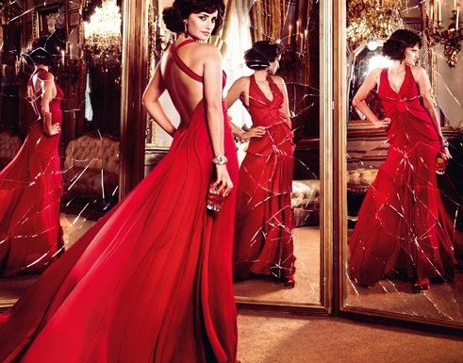
Product | Price | Place | Promotion
Compare the mix of two products: Campari Red passion and LV bags in a grid that considers the 4 P . What is the mix of each product?

Slide 11
Product | Price | Place | Promotion
Luxury | High | Selective | High positioning
Main stream | Medium | Extensive | High positioning
Compare the mix of two products: Campari Red passion and LV bags in a grid that considers the 4 P . What is the distinctive element of the mix for each product? Now find a product where each of the 4 Ps is prevalent.

Slide 12
1. Product

Slide 13
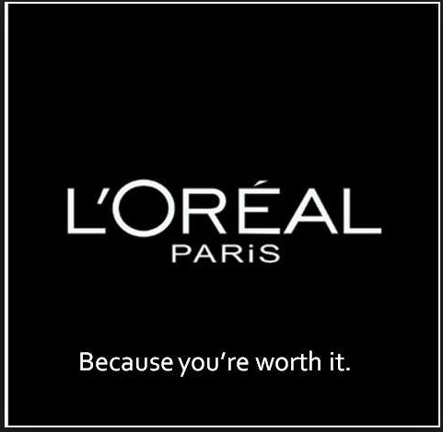
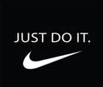
Elements of a product
A product has three elements:
1.Core benefits
What the product does . E.g. washing machine
2. Tangible or physical element
What the product is made of; what it looks like; E.g. :?
3. Unique Selling Point
The extra elements which add to the perceived value : tangible or intangible e.g. : “Because you’re worth it”. Often the augmented benefits of a product are determinant of whether a customer decides to buy or not.
What things did you recently buy for these reasons?

Slide 14
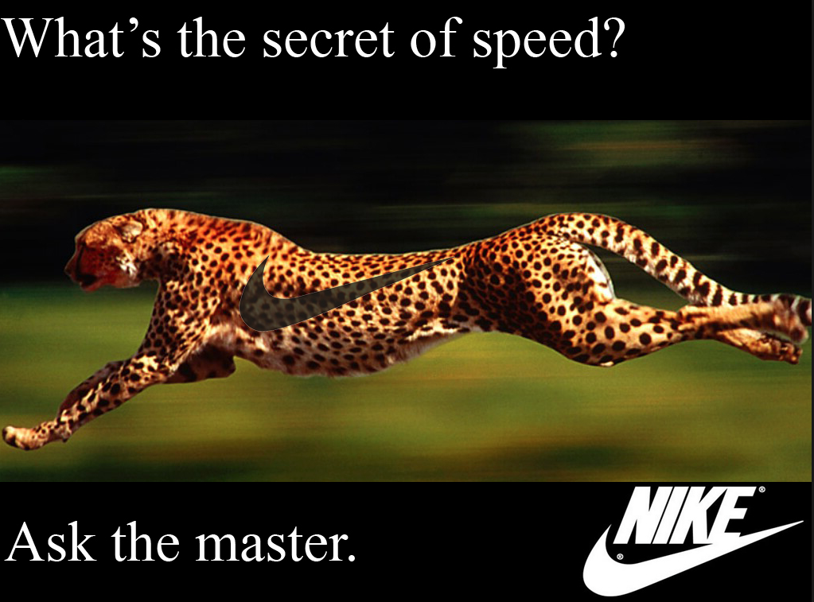
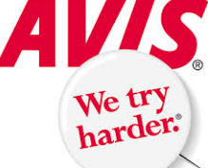
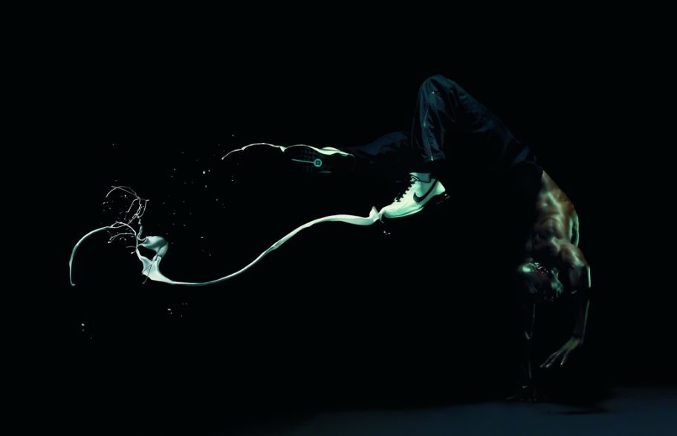
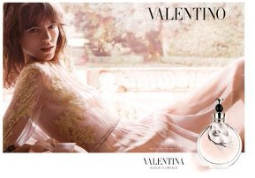
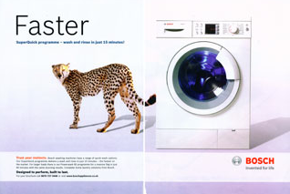
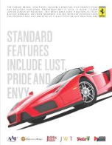
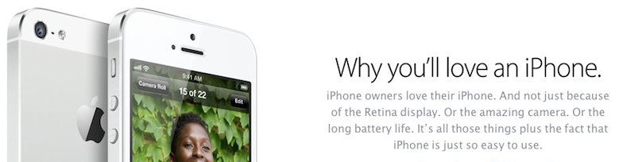
Making a product stand out : X Factor
A Unique Selling Point is a feature or benefit that separates a product from its competitors.
A USP could be a lower price a distinctive design, a strong brand , a performance,…..
A business needs to look at its unique selling points compared to competitors. If it doesn’t have any, the business will probably struggle to make the product seem attractive.
It’s the X Factor that customers’ buy. Can you name some products and their X Factor?

Slide 15
Brands
A brand is a product with unique character. It is consistent and well recognised in its tangible and intangible aspects.
THE PRODUCT /(core benefits ) +
THE NAME (proprietary signs, trademarks, symbols, logo) +
THE VALUES (brand promise) +
THE ADVERTISING (the image)
---------------------------------------------------------------------------------------------------
A BRAND
The opportunities arising from having a strong brand are:
customer loyalty
higher prices
brand stretching E.g. Pan di Stelle biscuits and cereals or cakes.
Some brands are so strong that they have become global brands. Apple, Nike, Coca Cola.

Slide 16
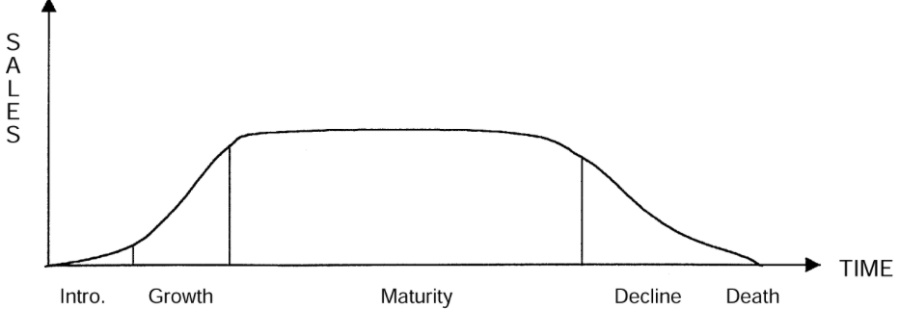
Product Life Cycle
The product life cycle is an important concept in marketing. It describes the stages a product goes through from when it was first introduced and finally removed from the market. Not all products reach this final stage. Some continue to grow and others rise and fall.
Can you name a product for each phase of the life cycle?

Slide 17
Product life cycles
Some goods can enjoy continuous growth, such as Microsoft softwares, because the product is being constantly improved and advertised, and maintains a strong brand loyalty.
Extension strategies extend the life of the product before it goes into decline.
The Life cycle of a product could be stretched by migrating abroad or by Innovation, or by a Price reduction, or through Advertising .
But it could also be brought to a quicker end : because of stiffer competition or because when a product becomes very visible, much of its appeal fades away

Slide 18
Product range
Most businesses sell more than one product.
What are the advantages of having a product range rather than just one product?

Slide 19
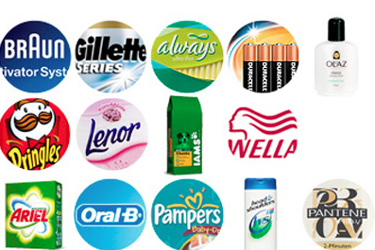
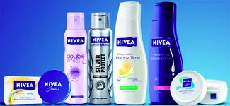
Product range
Some companies grow by speading the risk (take overs)
Some others by capitalizing on their brand image (Umbrella Branding)
Procter & Gamble
Nivea

Slide 20
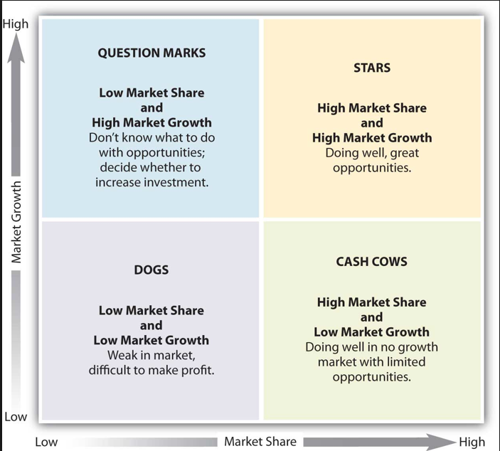
The Boston Matrix
Product range can be analysed using the Boston Group Consulting Matrix.

Slide 21
The Boston Matrix
Often Stars need heavy investment to sustain growth. Eventually growth will slow and, will become Cash Cows
they have potential, but may need substantial investment to grow their market share
These are mature, successful products with relatively little need for investment. continue to generate the strong cash flows that the company needs for its Stars
products that have a low market share in unattractive, low-growth markets. Dogs are usually sold or closed.
Put the following products in each square: Subaru cars in Italy, Iphone 5, Coca Cola.
Why should companies buy “dogs”? Why having a product in each square makes a balanced portfolio?

