Slide 1
Module 2
The Price and the Place

Slide 2
2. Price

Slide 3
What is price & pricing?
Price is: The money charged for a product or service. Price is not the same thing as cost.
The price a business charges for its product or service is one of the most important business decisions management take.
Pricing has to be consistent with the other elements of the marketing mix, since it contributes to the perception of a product or service by customers.
So pricing is really tough to get right. There are so many factors to consider, and much uncertainty about whether a price change will have the desired effect.
Can you make a list of the factors that influence the price setting?
98€ for a pair of trainers? Hmm … it’s Nike though
190€ for a hair cut?..It’s a lot but it’s a wedding…
40€ for a lesson of Latin?..Too much!:
9€ for a parfume? Who knows what’s in there!
Only 60€?..I thought more…
90 € for a Prada fake bought on the beach? No way!

Slide 4
The logic of pricing
PRODUCT N1: you have received two IPODs for your birthday. You decide not to open the second one and sell it on e-bay as “new”.
PRODUCT N2: You bought the X Box ,with your savings, then you realize you never play with it. You decide to sell it on e-bay. You realize there’s an enormous price range for the used ones. Which price would you settle with?
PRODUCT N3: You found a family heirloom –it’s a statue that represents an old myth -somewhere in your house and nobody wants it, you think it could have a value for someone visiting an antique market. You have no idea of the price /value because you didn’t find anything similar on the web. You go to a Sunday antique market to sell it.
What is the logic you would follow to set the right price?

Slide 5
Pricing approaches and strategies
1.Competitor-based pricing: Most firms in a competitive market do not have sufficient power to be able to set prices above their competitors. They tend to set a price that is in line with the prices charged by direct competitors.
2.Cost-based pricing: This involves setting a price by adding a fixed amount or percentage to the cost of making or buying the product. In some ways this is quite an old-fashioned and somewhat discredited pricing strategy, although it is still widely used.
3.Customer-based pricing: where prices are determined by what a firm believes customers will be prepared to pay.
However, there are many other factors that need to be taken into consideration such as state of the economy, state of the market, legislation, company’s objectives (eg promotional prices…), the other elements of the marketing mix, the life cycle of the product, the psychological state of mind of the buyer…….
Can you provide an example for each situation?.

Slide 6
Loss leaders
The use of loss leaders is a method of sales promotion. A loss leader is a product priced below cost-price in order to attract consumers into a shop or online store. The purpose of making a product a loss leader is to encourage customers to make further purchases of profitable goods while they are in the shop.
Customers will soon get used to the tactic, so it makes sense to often change the loss leader.
What are typical loss leaders in the supermarkets? Why?

Slide 7
Psychological pricing
Sometimes prices are set at what seem to be unusual price points. They will buy something for £9.99, but think that £10 is a little too much.
The aim of psychological pricing is to make the customer believe the product is cheaper than it really is.
It all started in the USA…

Slide 8
Our job
Think of having to set a price for some different items of a retailer brand (e.g coop), you must give them a price and you decide to follow different techniques of price setting for: Adapters, Panettone , High Quality Extra Virgin Oil, Coop Milk, Fresh Flowers, Toys .
Cost based
Customer based
Competition based
Loss Leader
Psychological price
In order to complete your task you must be thinking of the nature of the product, the competition and what normally applies better to it.

Slide 9
3. Place

Slide 10
The role of a Distribution Channel
A product might pass through several distribution channels before it finally reaches the consumer. The organizations involved in each stage of distribution are commonly referred to as “intermediaries”.
Why does a business give the job of selling its products to intermediaries? What are the advantages?

Slide 11
The role of a Distribution Channel
Know how, contacts
More efficient distribution logistics
Lower costs
Consumers may expect choice at the point of sale
Producers may not have sufficient resources to sell direct

Slide 12
Distribution Channels
Wholesalers stock a range of products from several producers, promote the products and sell on to retailers.
Agents sell the products and services of producers in return for a commission
Retailers Retailers always sell to the final consumer.
Franchises are independent businesses that operate a branded product in exchange for a fee and a share of sales.
Direct marketing means selling products by dealing directly with consumers rather than through intermediaries. (telemarketing, direct radio selling, on-line shopping )
Which is best?

Slide 13
Which is the “best choice”?
There is no best choice. The most suitable solution depends on the type of product, on the market , on the company ‘s goals (do I want to spread rapidly, or not? How much control do I want to have on my distribution? What type of product do I sell?..).

Slide 14
The lesson of Apple Retail History
Apple’s stores are among the most successful shops around, generating more revenue per square foot than any other retailer in the United States, including Tiffany. Apple's retail success is fuelled to a large extent by demand for the company's products.
But there are two more assets than can well explain this amazing success :
the customer service
the importance that Apple gives to the shopping “experience”
the lesson we learn is that
“Place can be a crucial Mkg tool and it ‘s no longer about distributing the product”

Slide 15
Apple Retail History
When Mr. Jobs returned to Apple in 1996 after being ousted 11 years earlier, the company was struggling. Fixing Apple's retail strategy was a priority for Mr. Jobs because Apple's brand had become so weak that mass retailers refused to stock Macintoshes.
But Mr. Jobs realized it was impossible to control the experience at mass retailers such as CompUSA. Building Apple's own retail stores was a natural progression. In 1999, Mr. Jobs recruited Millard Drexler, then president of Gap Inc., to join Apple and advise the company on retail strategy. Many members of Apple's initial retail team came from Gap, which was viewed as a model because of its hip image and success with its branded stores.

Slide 16
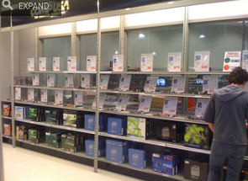
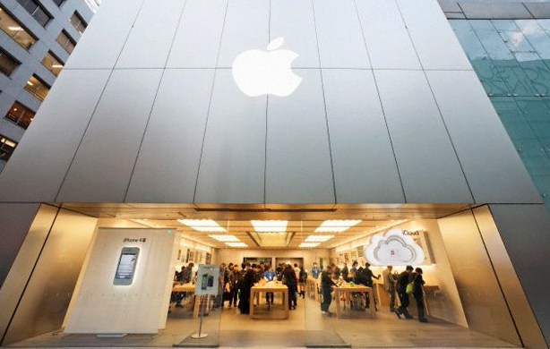
The shopping experience
1. It was Mr. Drexler's idea to build a prototype store in a warehouse near Apple headquarters. There, Apple designed a store layout that displayed its products in a way that highlighted how they could be used, rather than the conventional retail method of stacking products by category.
"People don't just want to buy personal computers anymore, they want to know what they can do with them"

Slide 17
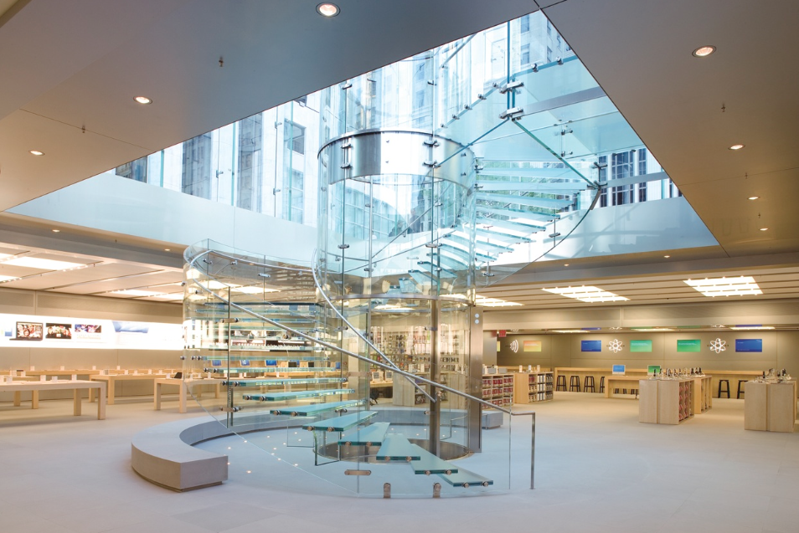
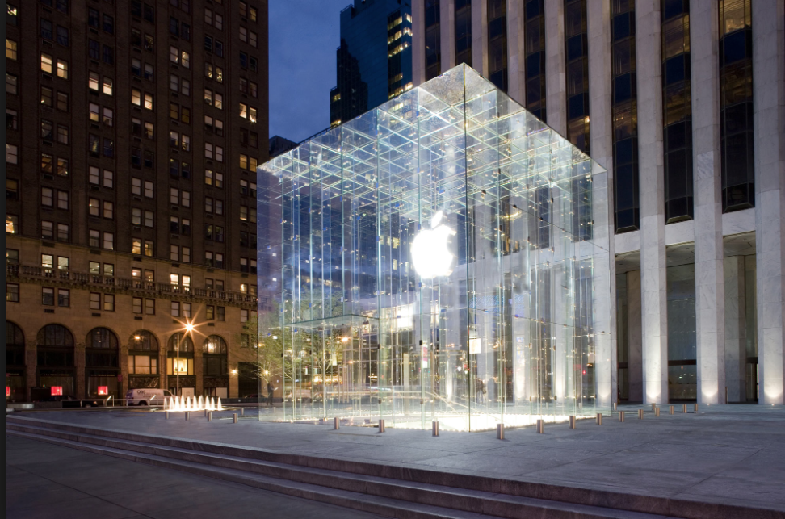
The shopping experience
2. At the time, electronics stores tended to resemble warehouses stuffed with accessories, pamphlets and cords. Apple, by contrast, chose an open plan with a clutter-free look, using natural materials like wood, glass, stone and stainless steel.
“People buy emotionally even though they justify their decision rationally.”

Slide 18
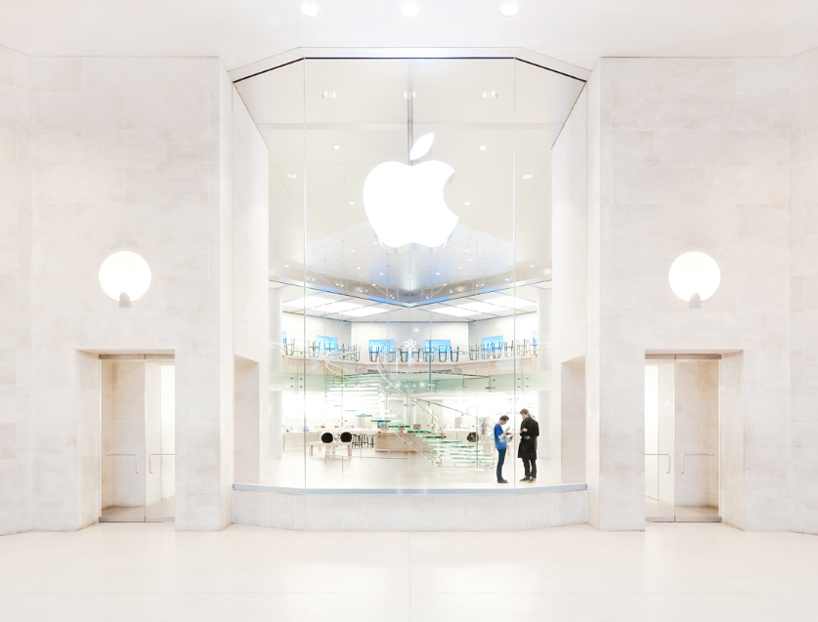
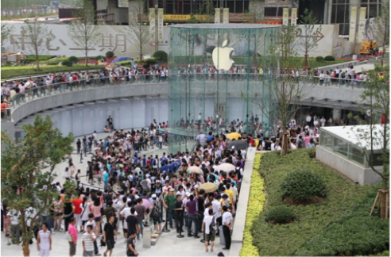
The shopping experience
Apple spent a year testing its concept before it opened its first two stores in May 2001. A little over two years later, it had opened over 70 stores in locations such as Chicago, Honolulu and Tokyo.
Over the past decade, Apple's stores have become even more dramatic, from a location inside the Louvre in Paris to one located under a 40-foot-high glass cylinder in Shanghai.

Slide 19
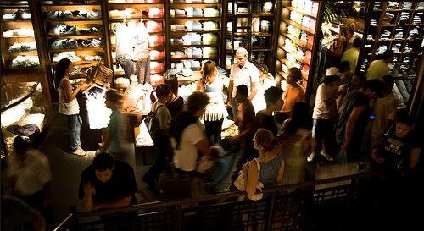
The shopping experience
What makes shopping a “shopping experience”? What are the elements you would consider to give the customers a shopping experience? What is a shop you know where you have it?

Slide 20
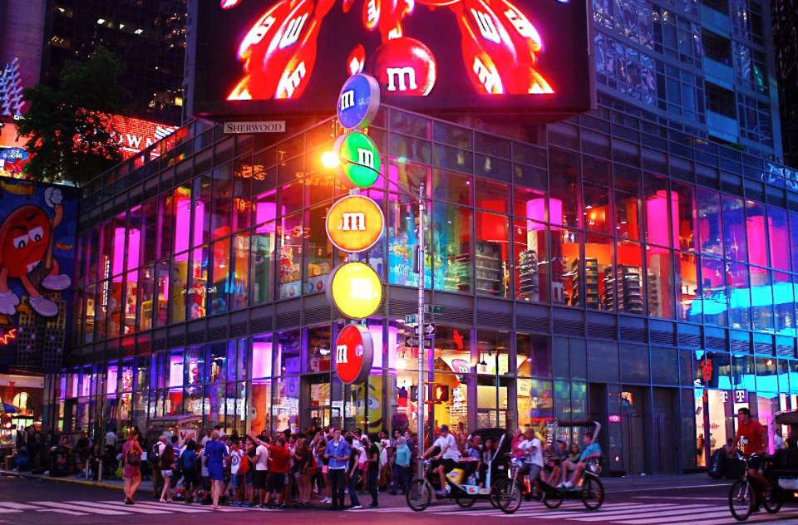
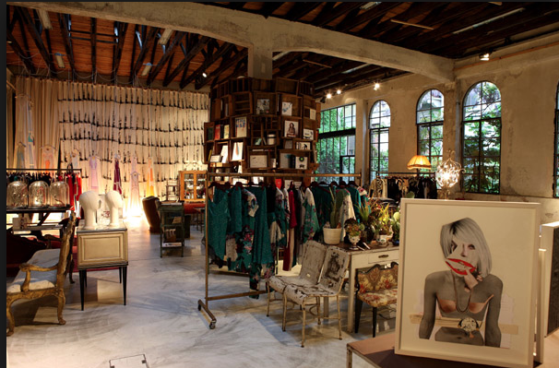
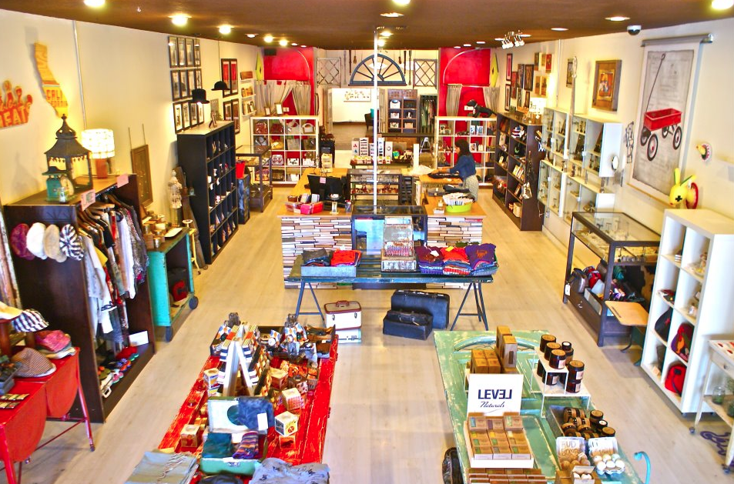
The shopping experience
Sensorial Experience
Interaction with
the product
Product range/quality
Surprise
Atmosphere

Slide 21
The shopping experience
key factor in determining whether a shopper will have a great experience include:
Design, Atmosphere
sensorial experience
product range/quality
surprise: seeing products which we wouldn’t expect to see there
service: making customers feel they're special.
However, the components of a great retail experience vary somewhat by the age, gender and nationality of shoppers. Consumers over age 50 are more likely to mention the importance of store representatives who seems genuine and caring. They also like being acknowledged and treated courteously, but this is not always true with younger customers.
What type of things do you give importance to when you shop?

Slide 22
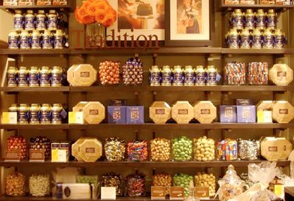
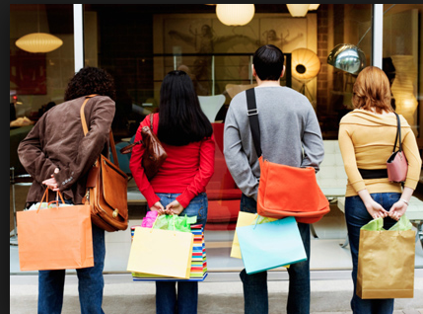
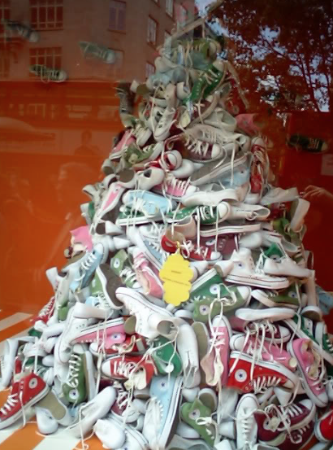
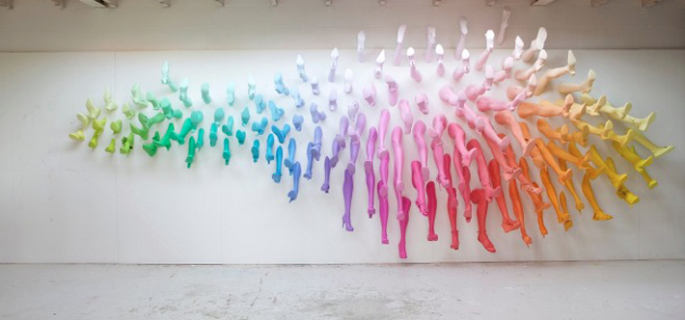
Visual Merchandising
Visual merchandising is about attracting potential customers into the shop and influencing the customer experience in order to motivate customers to buy. It includes window displays, signs, interior displays.
Visual merchandising professionals need to have an expertise in fashion, psychology, designing, psychology , architectural principles and Interior design.

Slide 23
Window VM
With the help of a few basic tips and ideas, any space can be turned into one that is visually appealing to people.
Make merchandise the focal point and use interesting themes. Customers give three to five seconds of their attention to window display. The retailers visual message should be conveyed to the customer in that short period of time.
Colour: Using color is the first way to attract attention. Bright happy colors are more likely to attract people, as opposed to dull colors. While having bright painted walls are one option, the other is that of using colored products and putting them on display.
Change Display Frequently/Give a theme: Using this technique is essential for the simple reason that it let's a person know what's new at the store, thus tempting them to walk into the store.

Slide 24
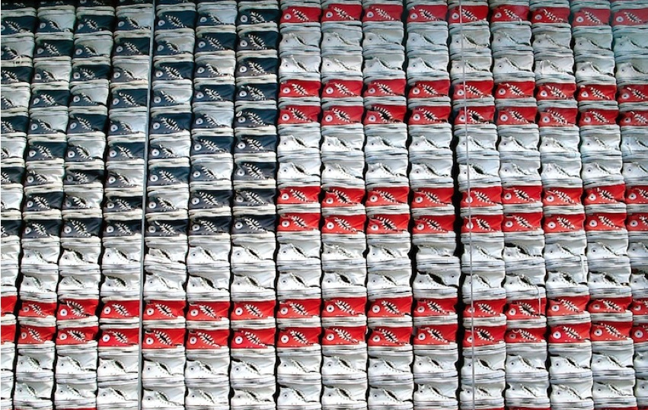
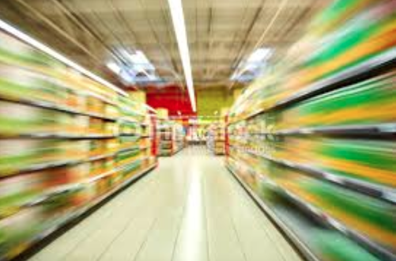
In store VM
Placing a guided path causes the customer to walk past all of the store's merchandise, increasing the chance of a sale.
display the most important items on a shelving system that reaches eye level and put unnecessary items first in the guided path
Balance the look of the display by using darker merchandise on the lower level of shelving and gradually place lighter-colored items toward the top of the shelving system.
Balance the size of the merchandise by placing a large item on one side, followed by a cluster of products directly opposite.
Install lighting in order to bring focus to the merchandise.
Create signage to attract attention and promote your display.

Slide 25
Your job
Choose a shop where you’ll be conducting your survey, go visit it :
1. is it offering a shopping experience? Why?Which elements are present? Which not?
2. Do you think in store display is casual? If not, what do you think the logic is?
3. What about the window? What did you observe?
4. How would you improve the quality of VM?
Prepare a short report and document your experience with some photographic material to show to the class.

